Slide 1

Department of Computer Science, CUI Lahore Campus
Formal Methods in Software Engineering
By
Farooq Ahmad

Slide 2
More Relation Operators
Domain and Range Subtraction, overriding operator, Relation Image

Slide 3
Topics Covered
Domain and range subtraction
Overriding operator
Relation image
developing predicates

Slide 4


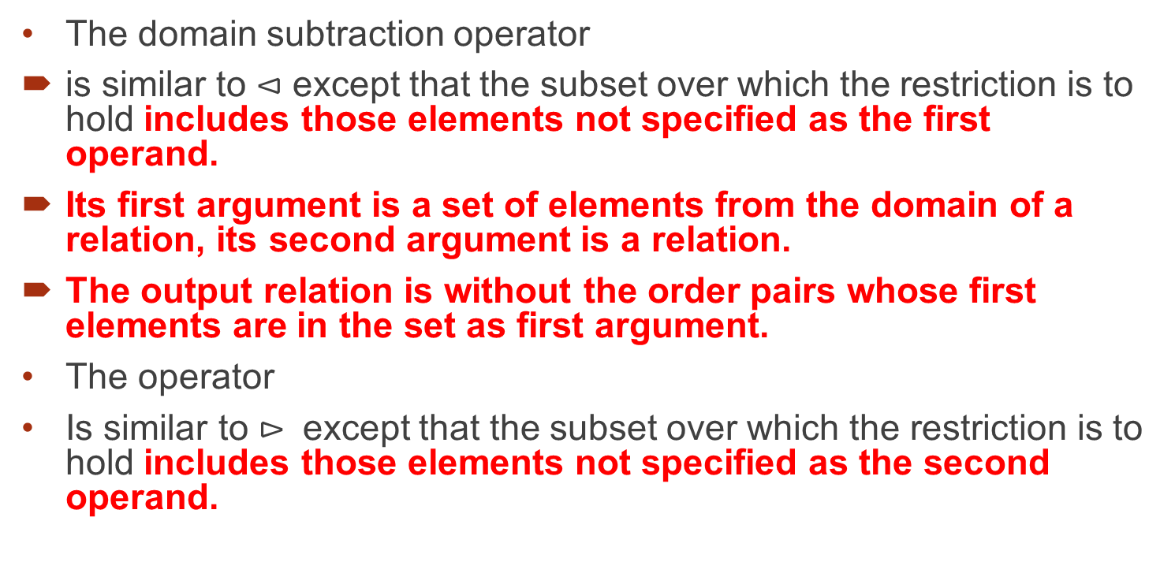
Domain and range subtraction
The domain subtraction operator
is similar to $⊲$ except that the subset over which the restriction is to hold includes those elements not specified as the first operand.
Its first argument is a set of elements from the domain of a relation, its second argument is a relation.
The output relation is without the order pairs whose first elements are in the set as first argument.
The operator
Is similar to $⊳$ except that the subset over which the restriction is to hold includes those elements not specified as the second operand.

Slide 5
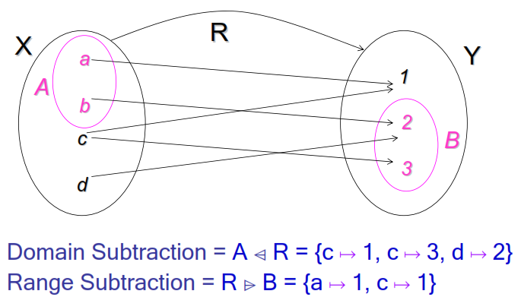
Example
R = {(a, 1), (b, 2), (c, 1), (c, 3), (d, 2) }
A={a, b}
B={2, 3}

Slide 6
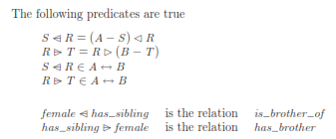
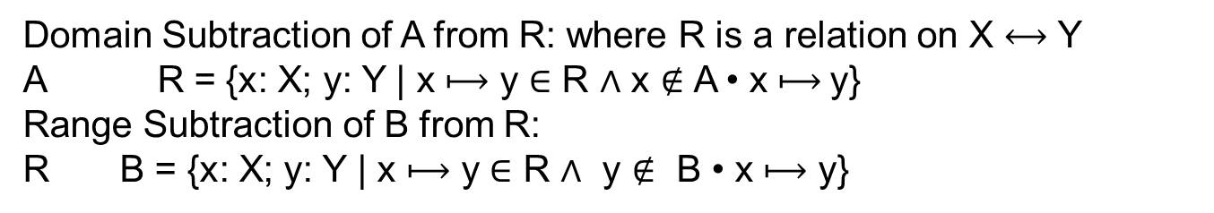
Definition of domain and rang subtraction
Domain Subtraction of A from R: where R is a relation on X $⟷$ Y
A R = {x: X; y: Y | x $⟼$ y ∈ R $∧$ x $∉$ A • x $⟼$y}
Range Subtraction of B from R:
R B = {x: X; y: Y | x $⟼$ y ∈ R $∧$ y $∉$ B • x $⟼$ y}
consider R : A $⟷$ B and S ⊆ A and T ⊆ B ; th e n

Slide 7
Example 2
In order to illustrate the use of domain subtraction operator consider the relation access_file over Users x Files which models the fact that a user can access a number of files where:
Users = {Williams, Thomas, Jones, Ross, Timms}
Files = {upd3, upd4, upd5, taxi, tax2, tax3}
and where the current value of access_file is {(Williams, upd3), (Thomas, upd4), (Jones, upd4), (Ross, tax1), (Ross, tax2), (Timms, upd3), (Timms, tax3)}.
Then the value of {Williams, Jones} access_files is {(Thomas, upd4), (Ross, taxi), (Ross, tax2), (Timms, upd3), (Timms, tax3)}.

Slide 8
Range subtraction operator: Example
The operator is similar to ► in its action.
For example, the value of
access_files {upd3, tax3} is {(Thomas, upd4), (Jones, upd4), (Ross, taxi), (Ross, tax2)}.
Notes:
The operator returns users of the files other than {upd3, tax3}

Slide 9
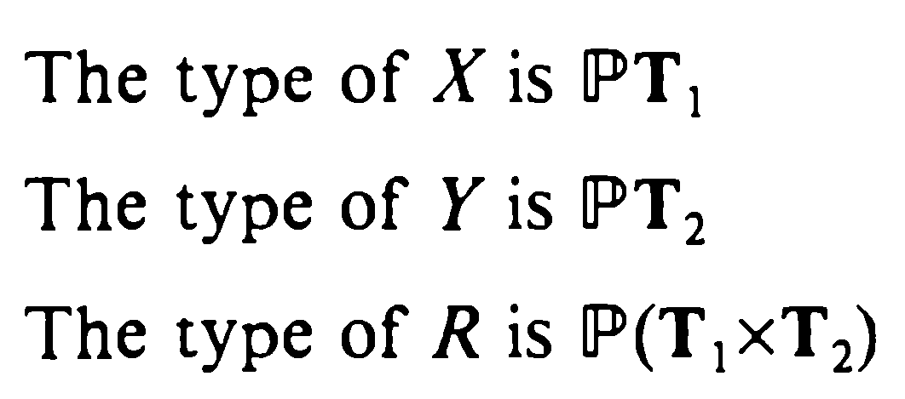
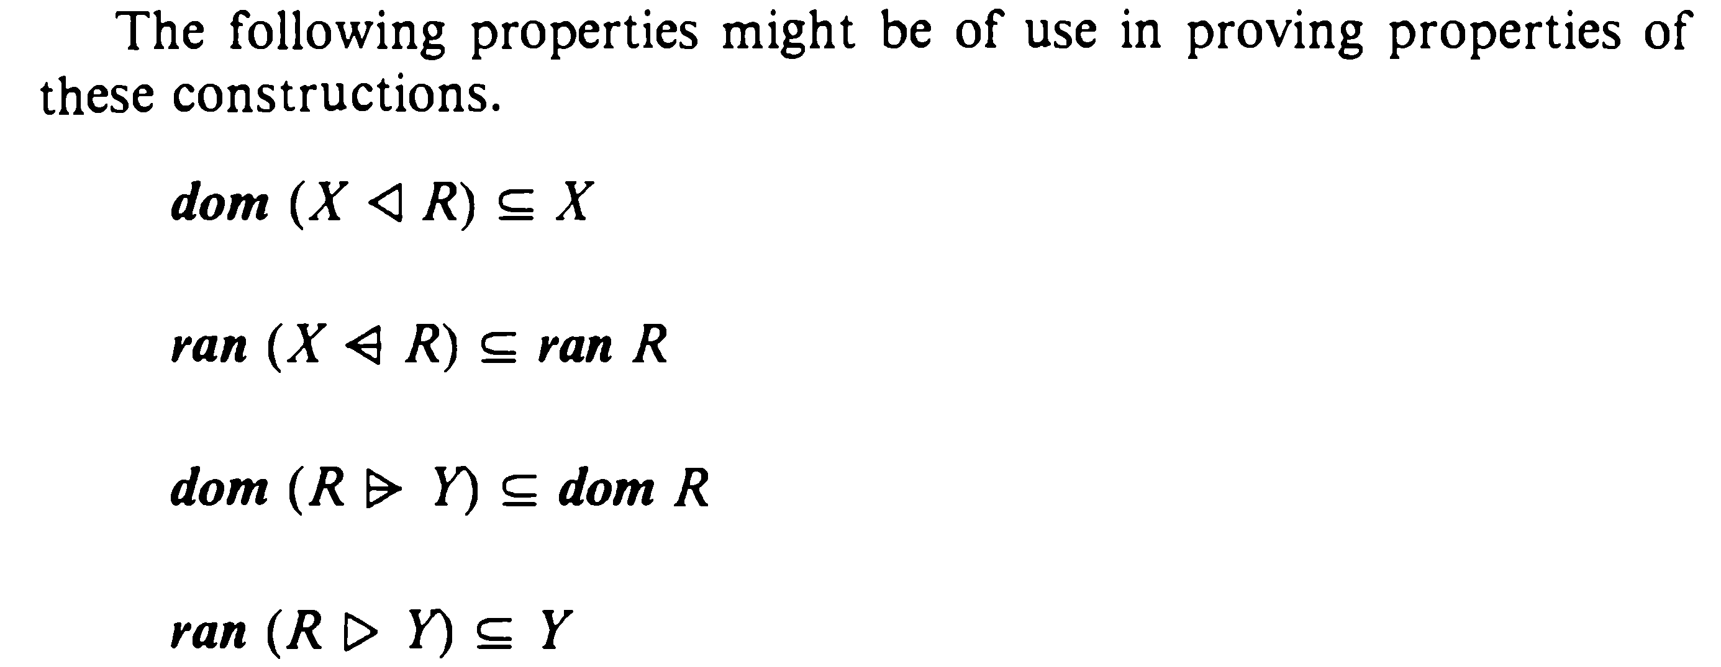
Properties of domain and range based operators

Slide 10
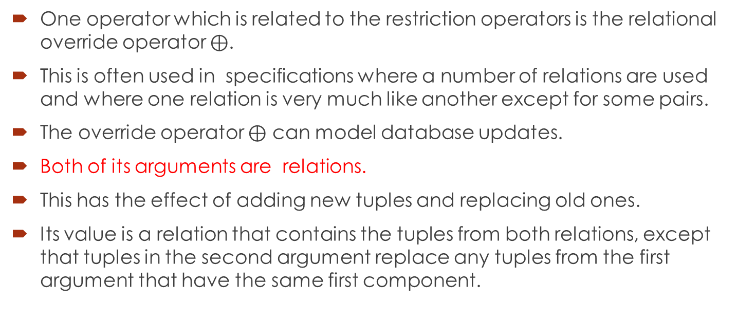
Override operation on relations
One operator which is related to the restriction operators is the relational override operator $⊕$.
This is often used in specifications where a number of relations are used and where one relation is very much like another except for some pairs.
The override operator $⊕$ can model database updates.
Both of its arguments are relations.
This has the effect of adding new tuples and replacing old ones.
Its value is a relation that contains the tuples from both relations, except that tuples in the second argument replace any tuples from the first argument that have the same first component.

Slide 11
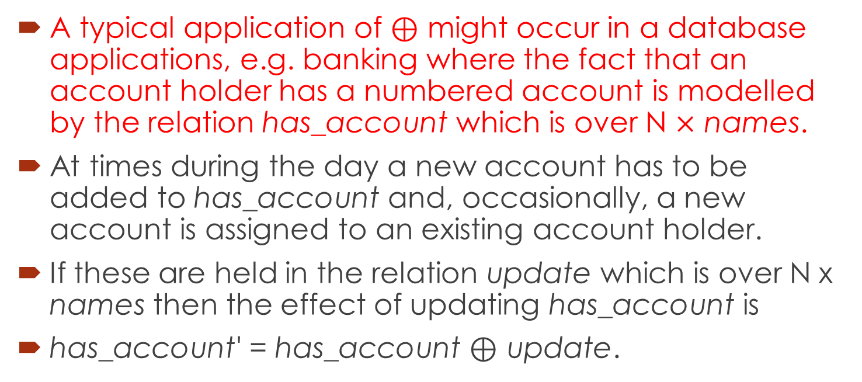
Application of overriding operator
A typical application of $⊕$ might occur in a database applications, e.g. banking where the fact that an account holder has a numbered account is modelled by the relation has_account which is over N $×$ names.
At times during the day a new account has to be added to has_account and, occasionally, a new account is assigned to an existing account holder.
If these are held in the relation update which is over N x names then the effect of updating has_account is
has_account' = has_account $⊕$ update.

Slide 12
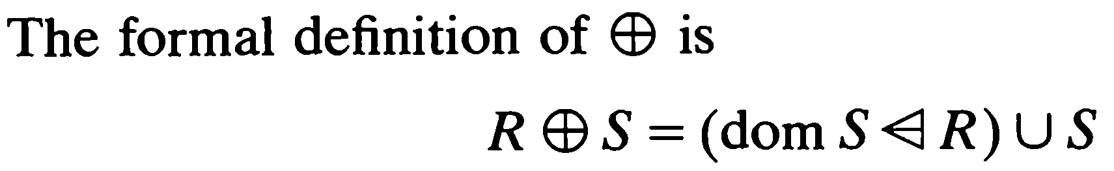
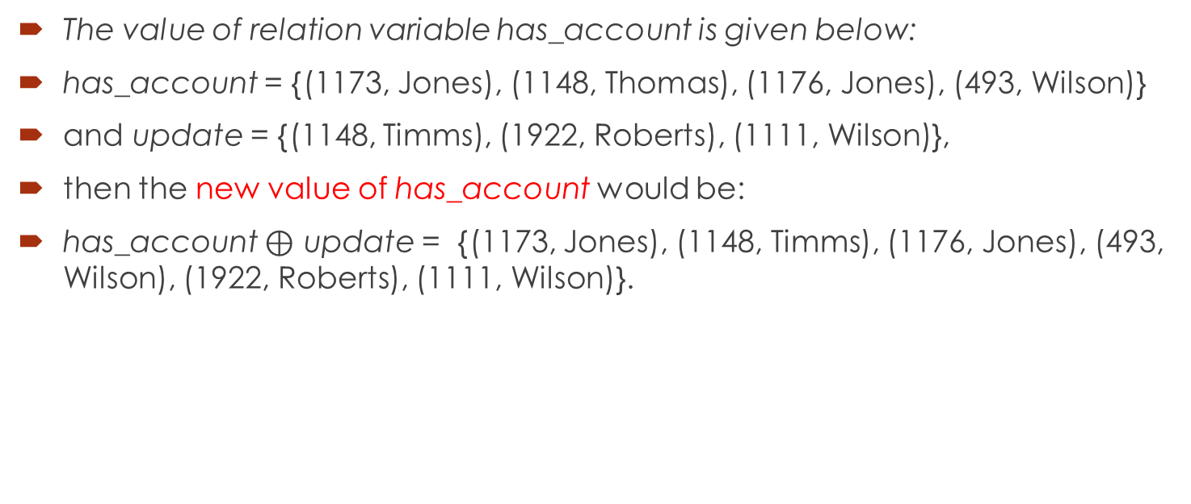
Example
The value of relation variable has_account is given below:
has_account = {(1173, Jones), (1148, Thomas), (1176, Jones), (493, Wilson)}
and update = {(1148, Timms), (1922, Roberts), (1111, Wilson)},
then the new value of has_account would be:
has_account $⊕$ update = {(1173, Jones), (1148, Timms), (1176, Jones), (493, Wilson), (1922, Roberts), (1111, Wilson)}.

Slide 13

Example 2
has_file = {(1, file1), (3, upd), (5, tax), (7, new), (8, upd)}
Update = {(1, newtax), (7, oldtax)}
{(1, file1), (3, upd), (5, tax), (7, new), (8, upd)} $⨁$ {(1, newtax), (7, oldtax)} $⇔$ {(1, newtax), (3, upd), (5, tax), (7, oldtax), (8, upd)}.
Find the answer using definition:

Slide 14
Relational image operator
Another useful operator is the set image (relational image) operator.
The relational image operator can model table lookup.
Its first argument is a relation, its second argument is a set of elements from the domain, and its return value is the set of corresponding elements from the range.
The image of a set S through a relation R is the set of elements which are second elements of pairs contained in R whose first elements are in S. Formally, the set image operator is represented by (| |).
To look up the numbers for Ali and Fahd in the phone relation, we use the relational image: phone(|{ali,fahd}|) = {4107, 4136, 0113}
The argument between brackets is not a single individual, it is an entire set, and the value of the image is another set.
Z encourages us to think in terms of entire sets and relations.

Slide 15
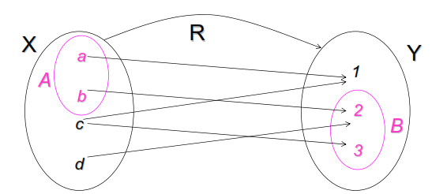

Example of relational image operator
R = {(a, 1), (b, 2), (c, 1), (c, 3), (d, 2) }
A = {a, b}

Slide 16
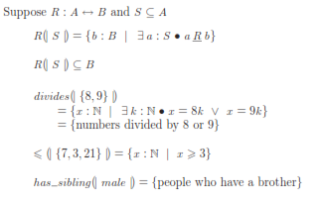
Formal definition of relational image

Slide 17
Relational image: Example 2
For example, if the set has_access is
{(Jones, tax2), (Roberts, tax3), (Roberts, upd), (Thomas, newupd), (Thomas, tax2), (Wilson, tax3), (Timms, trans)}
And if the set file_query was {Jones, Roberts}.
then has_access (| file_query |) would be {tax2, tax3, upd}.
If file _query = {Jones, Thomas}, then has_access (| file_query |) would be {tax2, newupd}
and has_access (| {Saad} |) would be the empty set { }.

Slide 18
Relation operators
Domain and range function
Inverse
Composition operator
Domain and range restriction
Domain and range subtraction
Overriding operator
Relational image

Slide 19
Constructing predicates about software design
In a library management system, let borrow_book : Person ↔ Book
Write a predicate to specify that a borrower p: Person can borrow at most 3 books
#({p} ◄ borrow_book) ≤ 3 OR
# (borrow_book ⸨{p}⸩ ) ≤ 3

Slide 20
Constructing predicated: Example 2
In a university management system, let registered: Student ↔ Course
Specify that a student std: Student can't register more than 5 courses in a semester.
#({std} ◄ registered) ≤ 5 OR
# (registered ⸨{std}⸩ ) ≤ 5

Slide 21
Constructing predicated: Example 3
In a university management system, let registered: Student ↔ Course
Not more than 50 students can be registered in a course c: Course.
#(registered ► {c}) ≤ 50
#dom(registered ► {c}) ≤ 50

Slide 22
Summary of the lecture: Conclusion
In this lecture, we learned to apply following operators:
Domain and range subtraction
Overriding operator
Relational image
Then we learned the use of all the relational operators to write predicates about the software design.

Slide 23
Reference and reading material
Chapter 4: Section 4.1.8 and 4.1.9 of the book “Software development with Z”

